Slide 1
4:Transformers & D.C. Motors

Slide 2
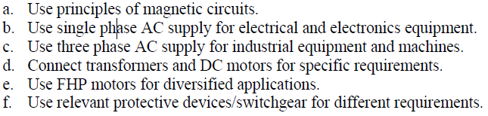

Slide 3
Course outcome
Connect transformers and DC motors for specific requirements.

Slide 4
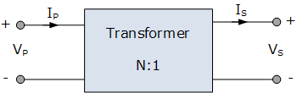
Introduction
The transformer is a static device (i.e. the one which does not contain any rotating or moving parts) which is used to transfer electrical energy from one ac circuit to another ac circuit, with increase or decrease in voltage/current but without any change in frequency.

Slide 5
Continued….
Function of transformer:
The electrical energy is generated and transmitted at extremely high voltages. The voltage is to be then reduced to a lower value for its domestic and industrial use.
This is done by using a transformer. Thus it is possible to reduced the voltage level using a transformer called step down transformer.
On the other hand, the transformer used to increase the voltage level is called step up transformer.
When the transformer changes the voltage level, it changes the current level also.

Slide 6
Principle of Operation
The construction of single phase transformer is as shown in fig. It consists of two highly inductive coils (windings) wound on an iron or steel core.
The winding connected to ac supply is called as primary winding whereas the other one is called as the secondary winding.
Operating principle of a transformer:
As soon as the primary winding is connected to the single phase ac supply, an ac current starts flowing through it.

Slide 7
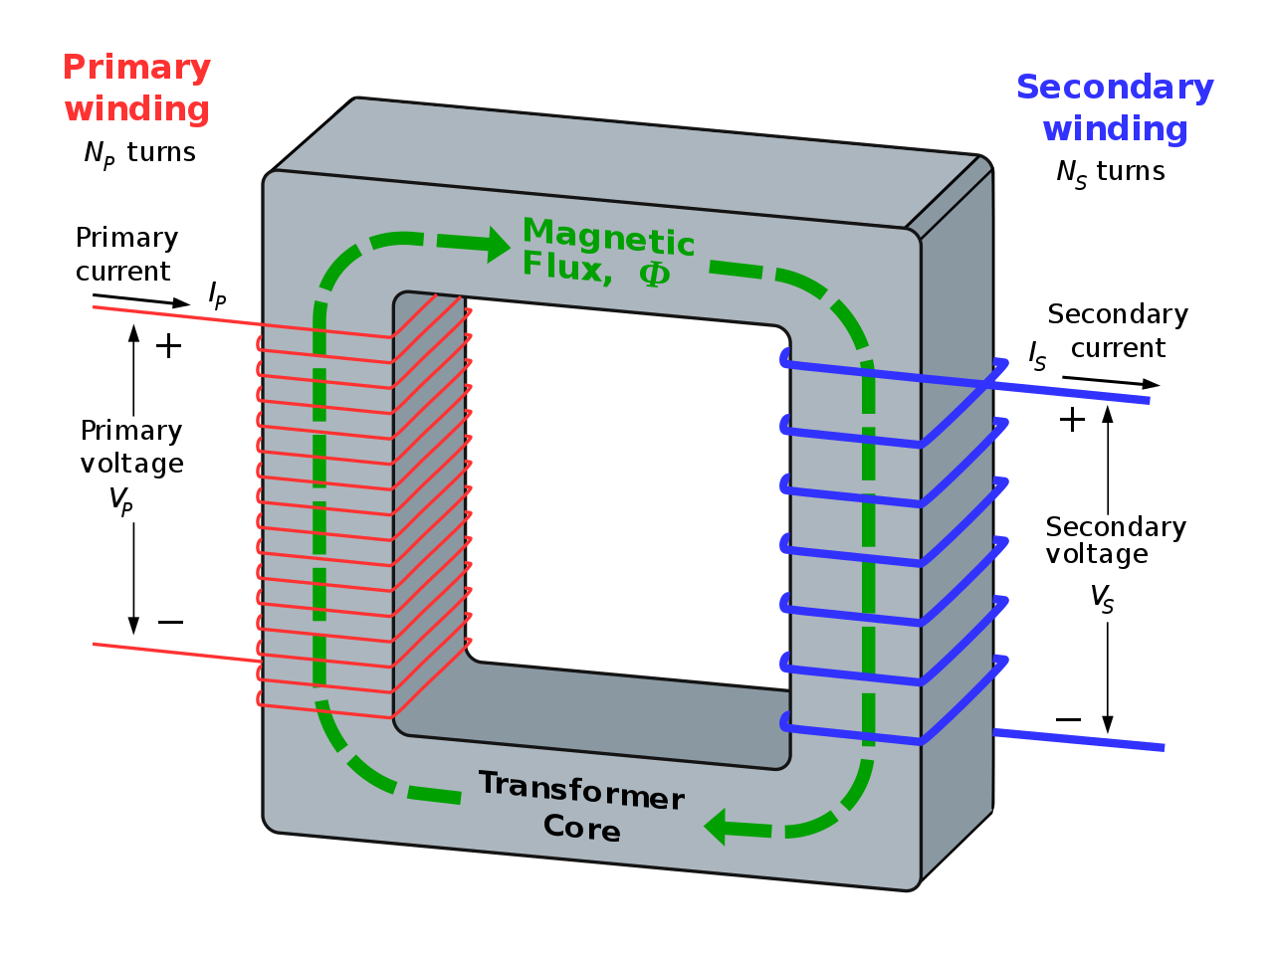

Slide 8
Continued….
2. The ac primary current produces an alternating flux ø in the core.
3. Most of this changing flux gets linked with the secondary winding through the core.
4. The varying flux will induce voltage into the secondary winding according to the Faraday’s law of electromagnetic induction.
Thus due to primary current, there is an induced voltage in the secondary winding due to mutual induction.
Hence the induced emf in secondary is called as the mutually induced emf.

Slide 9
Continued….
Can the transformer operate on DC?
Answer is NO. Because with a DC primary current, the flux produced in the core will not alternate, it is of constant value.
As there is no change in flux linkage, the induced emf in secondary winding is zero.

Slide 10
EMF equation of a transformer
In a transformer, source of alternating current is applied to the primary winding.
Due to this, the current in the primary winding (called as magnetizing current) produces alternating flux in the core of transformer.
This alternating flux gets linked with the secondary winding, and because of the phenomenon of mutual induction an emf gets induced in the secondary winding.
Magnitude of this induced emf can be found by using the following EMF equation of the transformer.

Slide 11
Continued…
Let, N₁ = Number of turns in primary winding N₂ = Number of turns in secondary winding Φ_{m} = Maximum flux in the core (in Wb) = (B_{m} x A) f = frequency of the AC supply (in Hz)
As, shown in the fig., the flux rises sinusoidally to its maximum value Φ_{m} from 0. It reaches to the maximum value in one quarter of the cycle i.e in T/4 sec (where, T is time period of the sin wave of the supply = 1/f). Therefore, average rate of change of flux = ^{Φ}_{m} /_{(T/4)} = ^{Φ}_{m} /_{(1/4f)} Therefore, average rate of change of flux = 4f Φ_{m} ....... (Wb/s).

Slide 12
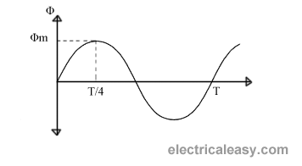
Continued…
Fig.(1)

Slide 13
Continued…
Now, Induced emf per turn = rate of change of flux per turn Therefore, average emf per turn = 4f Φ_{m} ..........(Volts).
Now, we know, Form factor = RMS value / average value Therefore, RMS value of emf per turn = Form factor X average emf per turn. As, the flux Φ varies sinusoidally, form factor of a sine wave is 1.11 Therefore, RMS value of emf per turn = 1.11 x 4f Φ_{m} = 4.44f Φ_{m}. RMS value of induced emf in whole primary winding (E₁) = RMS value of emf per turn X Number of turns in primary winding E₁ = 4.44f N₁ Φ_{m} ............................. eq (1)

Slide 14

Continued…
Similarly, RMS induced emf in secondary winding (E₂) can be given as E₂ = 4.44f N₂ Φ_{m}. ............................ (eq 2) from the above equations 1 and 2,

Slide 15
Continued…
This is called the emf equation of transformer, which shows, emf / number of turns is same for both primary and secondary winding. For an ideal transformer on no load, E₁ = V₁ and E₂ = V₂ . where, V₁ = supply voltage of primary winding V₂ = terminal voltage of secondary winding
Factors affecting the induced emf are:
Flux Φ_{m}
Frequency of applied voltage
Number of turns N.

Slide 16
Classification of Transformer
Classification based on Construction
Core Type: Core is inside & windings are outside
Shell Type: Core is outside & windings are inside

Slide 17
Classification based on Transformation Ratio(K)
If K>1 Step Up Transformer
If K<1 Step Down Transformer
If K=1 Autotransformer

Slide 18
Classification based on Number of phases
Single phase Transformer
Polyphase Transformer

Slide 19
Classification Based on Application
Power Transformer
Distribution Transformer
Control Transformer
Instrument Transformer

Slide 20
Numerical:
A 2000/200 V single phase 50Hz supply transformer has the maximum flux density 20mwb.Find the number of turns on the primary and secondary windings if the cross sectional area is 1.1cm2.

Slide 21
Numerical:
2. A single phase transformer of 50 Hz has maximum flux in the core as 0.021Wb. The number of turns in primary winding is 460 and on the secondary is 52.Calculate the emf induced in primary and secondary of the Transformer.

Slide 22
Numerical:
A single phase transformer has 350 primary turns & 1050 secondary turns is connected to a 400V 50Hz supply. If the net cross sectional area of the core is 50cm then find the maximum value of flux density and voltage induced in the secondary winding.

Slide 23
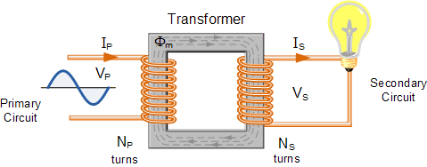
Voltage & Current ratios of a transformer
Fig.(1): Elementary single phase transformer

Slide 24
Continued…
Voltage ratios of the transformer with load:
As shown in fig.(1), let
N₁ = Number of turns in primary winding N₂ = Number of turns in secondary winding
E₁ = rms induced voltage in primary winding
E₂ = rms induced voltage in secondary winding
E₁ = 4.44f N₁ Φ_{m} volts
E₂ = 4.44f N₂ Φ_{m} volts
By taking the ratio of these expressions we get,
E₁ …(1)
N₁
=
E₂
N₂

Slide 25
Continued…
Voltage ratios of the transformer without load:
Assume the load on secondary winding is disconnected.
∴ I₂ = 0
∴ load terminal voltage v₂ is equal to secondary induced voltage E₂
i.e. V₂ = E₂ …….(2)
As the primary current on no load is very small,
V₁ = E₁ …….(3)
By substituting eq.(2) & (3) in eq.(1) we get,
V₁ N₁ ……(4)
=
V₂
N₂

Slide 26
Continued…
Voltage ratio:
The ratio of the primary and secondary terminal voltages (i.e. V₁ & V₂ ) is called as the voltage ratio.
Transformation ratio (k):
The transformation ratio for voltage is defined as the ratio of secondary voltage to the primary voltage of a transformer.
∴ K = V₂ = E₂ = N₂ ……(5)
V₁
E₁
N₁

Slide 27
Continued…
Turns ratio:
The turns ratio of a transformer is defined as the ratio of the number of primary turns to the number of secondary turns.
∴ turns ratio = N₁ …….(6)
Types of transformers based on the value of K:
Step up transformer:
If K > 1 or V₂ > V₁ is called step up transformer.
Step down transformer:
If K < 1 or V₂ < V₁ is called step down transformer.
N₂

Slide 28
Continued…
3. One-to-one transformer:
If K=1 or V₁ = V₂ is called as a one-to-one transformer. It is also known as the isolation transformer.
Current ratios:
The transformer transfer electrical power from one side to the other (primary to secondary) with a very high efficiency (η).
If we assume that the power loss taking place in the transformer is very low (η = 100%) then, we can write that
power input = power output
∴ V₁ I₁ cos ø₁ = V₂ I₂ cos ø₂ …….(7)
where I₁ and I₂ are the RMS values of the primary and secondary currents of the transformer respectively.

Slide 29
Continued…
cos ø₁ and cos ø₂ are the power factors of the primary and secondary sides of the transformer. Practically they are of same value.
∴ cos ø₁ = cos ø₂ …..(8)
∴ V₁ I₁ = V₂ I₂ …..(9)
∴ I₁ V₂ N₂ …..(10)
This expression shows that the primary & secondary currents are inversely proportional to the number of turns of the corresponding windings.
=
=
I₂
V₁
N₁

Slide 30
Rating of Transformer
Generally the rating of a machine should indicate the power supplied by it. But incase of transformer, the output power is not constant.
It keeps changing with the load. The output power factor is also a function of load.
Hence rating of a transformer is expressed in terms of voltage and current as follows:
Rating of transformer = Primary voltage x primary current
or = Secondary voltage x secondary current

Slide 31
Continued…
As the voltage and current may or may not be in phase, the units of transformer rating are Volt Ampere (VA) or kiloVolt-Ampere (kVA) or Mega Volt Ampere (MVA).
∴ Rating in VA or kVA or MVA = V₁ x I₁ = V₂ x I₂
Why is the transformer rated in VA or kVA?
There are two type of losses in a transformer; 1. Copper Losses 2. Iron Losses or Core Losses or Insulation Losses
Copper losses ( I²R)depends on Current which passing through transformer winding while Iron Losses or Core Losses or Insulation Losses depends on Voltage.

Slide 32
Continued…
Hence the total losses depends on the volt ampere (VA) and not on the power factor. Therefore rating of transformer is in VA or kVA and not in kW.
The complete rating of a transformer:
The complete rating of a transformer includes the ratio of primary and secondary voltages, kVA rating and supply frequencies as follows:
3300 V/ 240 V , 5 kVA , 50 Hz
where, 3300 V is primary voltage V₁
240 V is secondary voltage V₂
5 kVA is kVA rating and 50 Hz is the supply frequency.

Slide 33
Continued…
Specifications of transformer:
When transformer is to be purchased, we have to consider following specifications:
kVA rating 2. Number of phases
3. Primary voltage 4. Secondary voltage
5. Primary current 6. Secondary current
7. Frequency of operation
8. Types of cooling

Slide 34
Numerical:
A single phase 50Hz 230/110v 1KVA transformer is fully loaded. Find its primary and secondary current also find the current at half load. Neglect losses.

Slide 35
Numerical:
A 1-Phase, 1 kVA, 230/115 V transformer used in a laboratory. Calculate: (i) Primary winding current (ii) Secondary winding current (iii) Turns Ratio and (iv) Current Ratio.

Slide 36
Losses in a Transformer
An ideal transformer is loss free. But in the practical transformer there are following losses taking place.
Copper losses (P_{c})
Iron losses (P_{i}):
i. Hysteresis losses
ii. Eddy current losses

Slide 37

Continued…
Copper Loss (P_{c}):
The total power loss is taking place in the winding resistances of the transformer is known as the copper loss.
∴ Copper loss = Primary copper loss + Secondary copper loss
The copper loss is denoted by P_{c} .
where, R₁ and R₂ are resistances of primary and secondary winding respectively.

Slide 38
Continued…
The copper loss should be kept as low as possible to increase the efficiency of the transformer.
To reduced the copper loss, it is essential to reduce the resistances R₁ and R₂ of primary and secondary winding.
Copper losses are also called as variable losses as they are dependent on the square of load current.

Slide 39
Continued…
Iron loss (P_{i}):
Iron loss P_{i} is the power loss taking place in the iron core of the transformer.
P_{i} = Hysteresis Loss + Eddy current loss
Hysteresis losses:
Hysteresis loss is directly proportional to frequency f and voltage V. it is given by
P_{H} = K_{H} B_{m}^{1.67} fV …..[K_{H} constant]

Slide 40
Continued…
Eddy current losses:
Eddy current loss is proportional to square of frequency and square of thickness of laminations. It is given by,
P_{E} = K_{E} B_{m}² f².t² ……[t = thickness]
Due to time varying flux, there is some induced emf in the transformer core. This induced emf causes some currents to flow through the core body. These currents are known as the eddy currents.
The eddy current loss can be minimized by using laminated core for transformer.

Slide 41
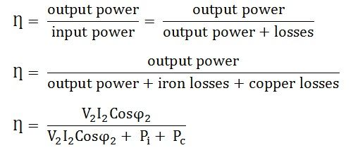
Efficiency & Regulation
Efficiency (η):
The efficiency of a transformer is defined as the ratio of output power to input power. It is denoted by η.
………………(1)

Slide 42
Continued…
Voltage regulation:
Ideally, the secondary terminal voltage V₂ (or load voltage) of a transformer should remain constant independent of the load current.
But practically the load voltage decreases with increase in load current I_{L}.
No load Voltage:
The no load voltage is the secondary terminal voltage corresponding to zero load current. For a transformer
No load voltage = E₂ volts

Slide 43

Continued…
Full load voltage:
It is secondary terminal voltage (V₂) corresponding to the specified load current. The percent voltage regulation is given by mathematically as:
……(1)
Thus with increase in load current, the value of V2 decreases and the percent regulation increases. Ideal value of voltage regulation is 0%.

Slide 44
Continued…
Definition of voltage regulation:
The voltage regulation of a transformer is defined as the change in secondary terminal voltage(V2) from no load to full load with the primary source voltage (V1) and the temperature of the transformer maintained constant.
The regulation is positive for resistive and inductive loads and it can be negative for the capacitive load.

Slide 45
Numerical:
A 5KVA 230/115V Transformer has following losses. Pi=10w Pcu =400w. Calculate a full load efficiency and half load efficiency when the power factor of the circuit is 0.8 lagging.

Slide 46
Numerical:
A 100KVA single phase Transformer has the copper loss 3kw and iron loss of 2kw.Find the efficiency of the transformer at full load and half load for the unity power factor.

Slide 47
Advantages of Transformer
It provides the complete Isolation between primary winding and secondary winding.
It has no moving parts.
Its construction is simple.
We can step up and step down the voltage.

Slide 48
Disadvantage:
Large size
Poor voltage regulation.
High power Loss in the windings.
More copper is required to be used because it has two windings.

Slide 49
Applications:
As a distribution transformer.
Isolation Transformer.
As a step down transformer in the DC power supplies.

Slide 50
Autotransformer
The normal transformer has separate primary and secondary windings.
But the autotransformer is a special transformer in which a part of winding is common for the primary and secondary windings.
The construction of autotransformer is as shown in fig. (1).
It consists of only one winding wound on a laminated magnetic core, with rotary movable contact. Thus form the autotransformer three terminals are brought out for connection.
The autotransformer can operate as a step down or a step up transformer.

Slide 51
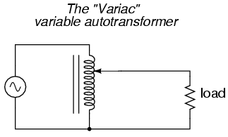
Continued…
Fig.(1): Autotransformer

Slide 52
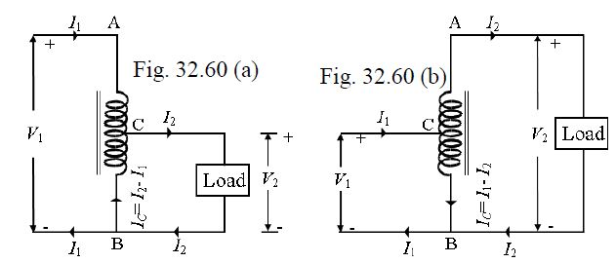
Continued…
Fig.2(a):Step down autotransformer fig.2(b):step down autotransformer

Slide 53
Continued…
Applications of autotransformer:
It can be used as a variac, i.e. variable ac supply to vary the ac voltage applied to the load smoothly from 0 V to about 270 V.
In order to start the ac machines such as induction motors or synchronous motors.
To vary the supply voltage (as per requirement) of a furnace.
As a dimmerstat: when the variac autotransformer is used to control the intensity of lamps in the cinema halls etc., it is called as the dimmerstat.

Slide 54
Continued…
Comparison of two winding transformer and autotransformer:
Sr. no. | Parameter | Autotransformer | Conventional transformer
1. | Definition | A transformer, having only one winding a part of which acts as a primary and the other as a secondary. | It is a static machine which transfers electrical energy from one end to another without changing frequency.
2. | Number of Windings | Auto-transformer has only one winding wound on a laminated core | It has two separate winding, i.e., primary and secondary winding.
3. | Insulation | The primary and secondary winding are not electrically insulated. | The primary and secondary winding are electrically insulated from each other.

Slide 55
Continued…
Sr. no. | Parameter | Autotransformer | Conventional transformer
4. | Induction | Self Induction | Mutual Induction
5. | Size | Small | Large
6. | Power Transfer | Partly by transformation and partly by direct electrical connection. | Through transformation
7. | Voltage Regulation | Better | Good
8. | Winding Material | Less requires | More requires
9. | Circuit | The primary and secondary winding circuits are connected magnetically. | The primary and secondary winding circuits are connected both electrically and magnetically.
10. | Connection | Depends upon the tapping | Connect directly to the load.
11. | Starting current | Decreases | Decreases by 1/3 times.

Slide 56
Continued…
Sr. no. | Parameter | Autotransformer | Conventional transformer
12. | Excitation current | Small | Large
13. | Economical | More | Less
14. | Cost | Less costly | More costly
15. | Efficient | More | Less
16. | Leakage flux and resistance | Low | High
17. | Impedance | Less | High
18. | Cost | Cheap | Very costly
19. | Losses | Low | High
20. | Output voltage | Variable | Constant.
21. | Applications | Use as a starter in an induction motor, as a voltage regulator, in railways, in a laboratory. | Use in power system for step up and step down the voltage.

Slide 57
DC MOTOR

Slide 58
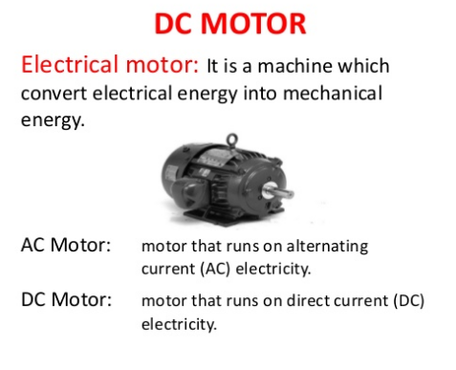

Slide 59
Introduction
The Dc machines are of two types namely DC generators and DC motors.
A DC generators converts mechanical energy into electrical energy whereas a DC motor converts the electrical energy into mechanical energy.
In order to understand the operating principle of a DC motor, it is necessary to understand how does a current carrying conductor experience a force, when kept in a magnetic field.

Slide 60
Force on current carrying conductor:
If a straight conductor is placed in the magnetic field produced by a permanent magnet, the current flowing through a conductor in anti clockwise direction.
Due to the presence of two magnetic fields simultaneously, an interaction between them will take place as shown in fig.(1).

Slide 61
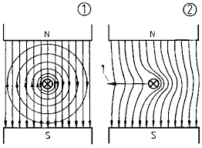
Fig.1(a): Interaction of the fields Fig.1(b):Resultant field

Slide 62
As shown in fig.(1), the flux lines produced by the magnet and the conductor are in opposite direction to each other at left side and hence cancel each other. Therefore the no of flux lines at left side will reduced.
At the right side, the individual fields are in the same direction, hence will add or strengthen each other. Therefore the no. of flux lines at right side will increase.

Slide 63
Magnitude of Force:
The magnitude of the force experienced by the current carrying conductor placed in the magnetic field is given by,
F = BIl Newton
Where B = Flux density produced by Magnet
I = current flowing through conductor
l = Length of the conductor

Slide 64
Direction of force:
The direction of rotation of a motor depends on the direction of force exerted on the the armature winding and the direction of force experienced by a current carrying conductor is given by Fleming’s left hand rule.
Statement of Fleming’s left hand rule:
It states that if the first three fingers of the left hand are held mutually at right angles to each other and if index finger indicates the direction of the magnetic field, and if middle finger indicates the direction of current flowing through the conductor, then thumb indicates the direction of force exerted on the conductor. This is shown in fig (2).

Slide 65
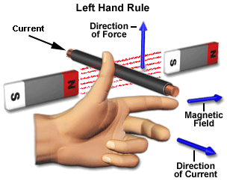
Fig.(2):Fleming’s left hand rule thumb

Slide 66
Windings in DC Machine
In any dc machines, there are two windings:
Field winding 2. Armature winding
Out of these, the field winding is stationary which does not move at all and armature winding is mounted on a shaft. So it can rotate freely.
Connection of windings for operation as motor:
To operate the dc machine as a motor, the field winding and armature winding is connected across a dc power supply.

Slide 67
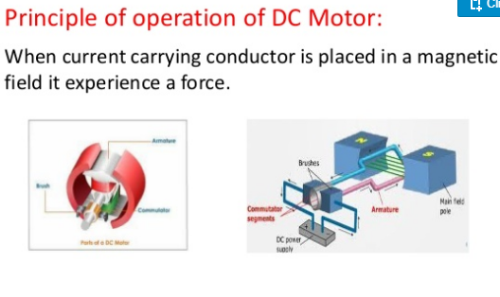

Slide 68
DC Motor
Principle of operation:
When current carrying conductor is placed in a magnetic field, it experienced a force.
In case of DC motor, the magnetic field developed by the field current i.e. current flowing in field winding and armature winding plays the role of current carrying conductor
So armature winding experienced a force and start rotating.

Slide 69
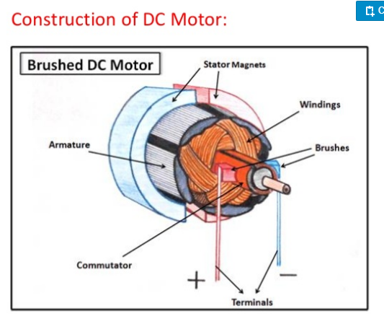

Slide 70
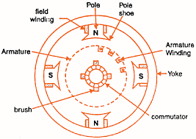
Construction of DC Motor
Fig.(1): construction of DC motor

Slide 71
Important parts of DC motor:
Yoke 4. Armature
Field winding 5. Commutator, brushes & gear
poles 6. Brushes
Yoke:
It acts as the outer support of a DC motor.
It provides mechanical support for the poles.

Slide 72
2. Poles:
pole of a dc motor is an electromagnet.
The field winding is wound over the poles.
Poles produces magnetic flux when the field winding is excited.
3. Field winding:
The coils wound around the pole are called field coils and they are connected in series with each other to form field winding.
When current passing through the field winding, magnetic flux produced in the air gap between pole and armature.

Slide 73
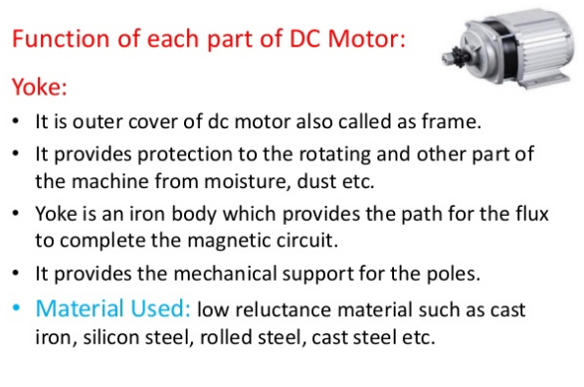

Slide 74
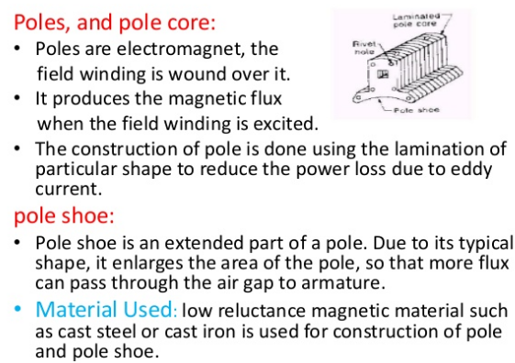

Slide 75
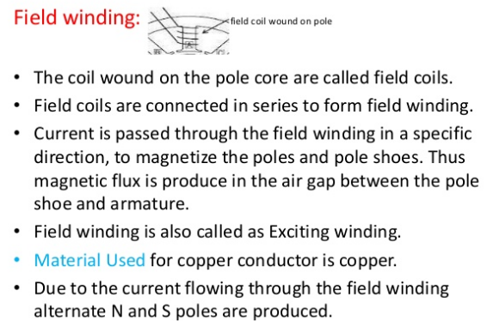

Slide 76
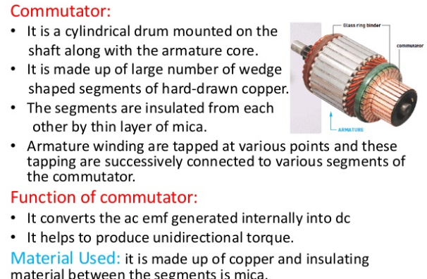

Slide 77
4. Armature:
Armature is a cylindrical drum mounted on shaft in which number of slots are provided.
Armature conductors are placed in these slots.
Theses armature conductors are interconnected to form the armature winding.
5. Commutator:
A commutator is a cylindrical drum mounted on the shaft alongwith the armature core.
It collects the current from the armature conductors and passed it to the external load via brushes.

Slide 78
6. Brushes:
Commutator is rotating. So it is not possible to connect the load directly to it.
Hence current is conducted from the armature to the external load by the carbon brushes which are held against the surface of commutator by springs.

Slide 79
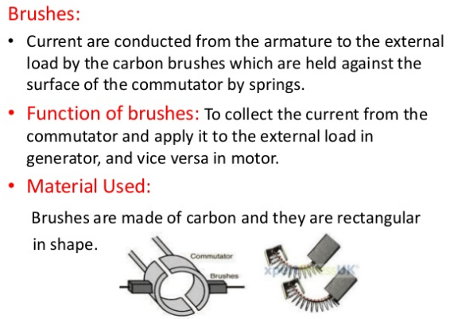

Slide 80
Types of DC Motors
Depending on the way of connecting the armature and field windings of a d.c. motors are classified as follows:
DC Motor
DC series motor
Shunt motor
Compound motor
Separately excited motor
Short shunt compound motor
Long shunt compound motor

Slide 81
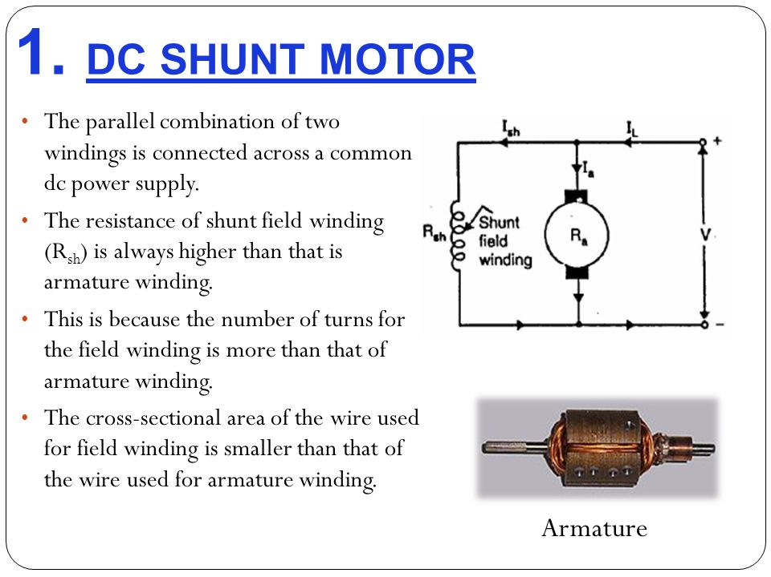
DC Shunt Motor
In DC shunt type motor, field and armature winding are connected in parallel as shown in fig.(1), and this combination is connected across a common dc power supply.

Slide 82
Shunt motor applications:
Various machine tools such as lathe machines, drilling machines, milling machines etc.
Printing machines
Paper machines
Centrifugal and reciprocating pumps
Blowers and fans etc.

Slide 83
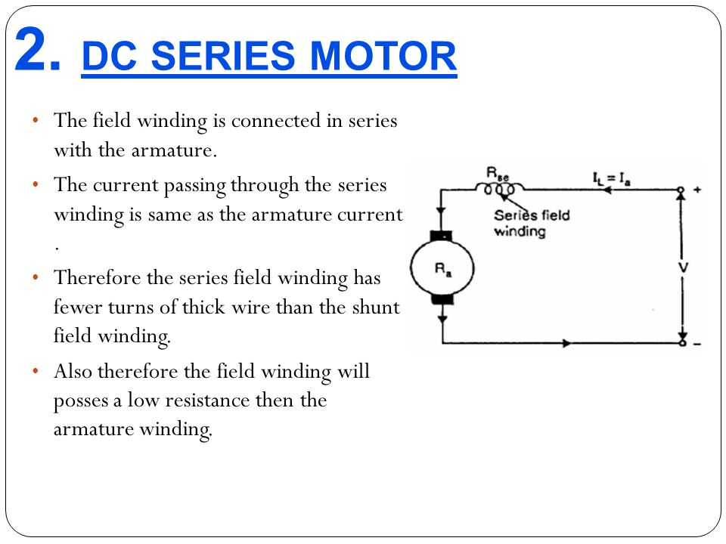
DC Series Motor
In DC series motor, the armature and field windings are connected in series with each other as shown in fig.(1).

Slide 84
Series motor applications:
Electric trains
Diesel-electric locomotives
Cranes
Hoists
Trolley cars and trolley buses
Rapid transit systems
Conveyers etc.

Slide 85
DC Compound Motor
Long Shunt Compound Motor:
As shown in fig.(1), in long shunt dc motor, shunt field winding is connected across the series combination of the armature and series field winding.
2. Short Shunt Compound Motor:
In short shunt compound motor, armature and shunt field windings are connected in parallel with each other and this combination is connected in series with the series field winding. This is shown in fig.(2).
The long shunt and short shunt compound motors are further classified as cumulative and differential compound motors

Slide 86
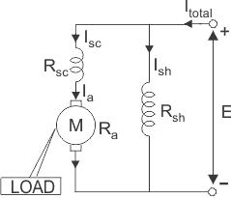
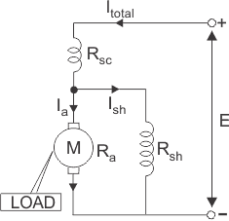
Fig.(1): Long shunt compound dc motor fig.(2):Short shunt compound dc motor

Slide 87
3. Cumulative compound motor applications:
Elevators
Rolling mills
Planers
Punches
Shears
4. Differentials compound motors applications:
The speed of these motors will increase with increase in the load, which leads to an unstable operation.
Therefore we can not use this motor for any practical applications

